Slide 1
This is Marco…

Slide 2
He sells
PV-systems

Slide 3

Marco drives
two hours to his
next customer!
Notes:
lost time

Slide 4
But Marco
only knows name and address of his next customer…
Notes:
sometimes

Slide 5


Slide 6



Minerva
delivers
customised information
decreases
time for
sale cycles
increases
acceptance
rate

Slide 7
Now, back to Marco…

Slide 8
Minerva provides Marco with context

Slide 9
How does this work?

Slide 10
The Minerva workflow
Lead
incoming
Client
Information
Minerva
Research

Slide 11
Minerva Research
RAG
₁
Retrieve and return
Question
Retrieve
Retrieve more
40% customisation
1 = Retrieval Augmented Generation

Slide 12

Minerva Research
RAG
Landgraph
4-Agent
Architecture
Orchestration
Retrieve and return
Sub Agent 1
Sub Agent 3
Question
Sub Agent 2
Retrieve
Web Search
Sales knowledge
Review
Pattern recognition
Agent
Skills
Satelite Data
Industry Knowledge
Internal Data
Proposal:
Retrieve more
Skill
always in
use
Psychological Frameworks
40% customisation
Output
100% customised answer

Slide 13
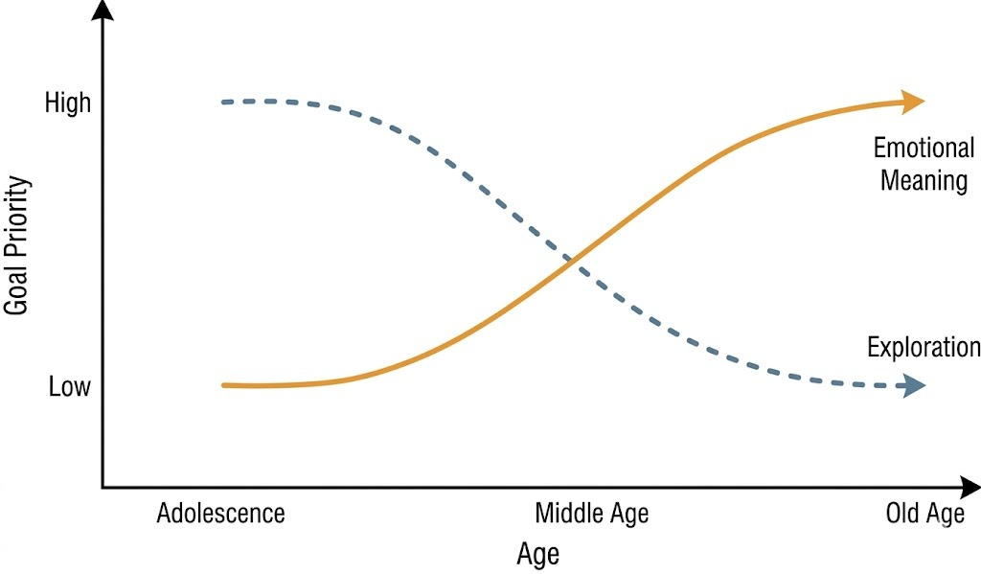
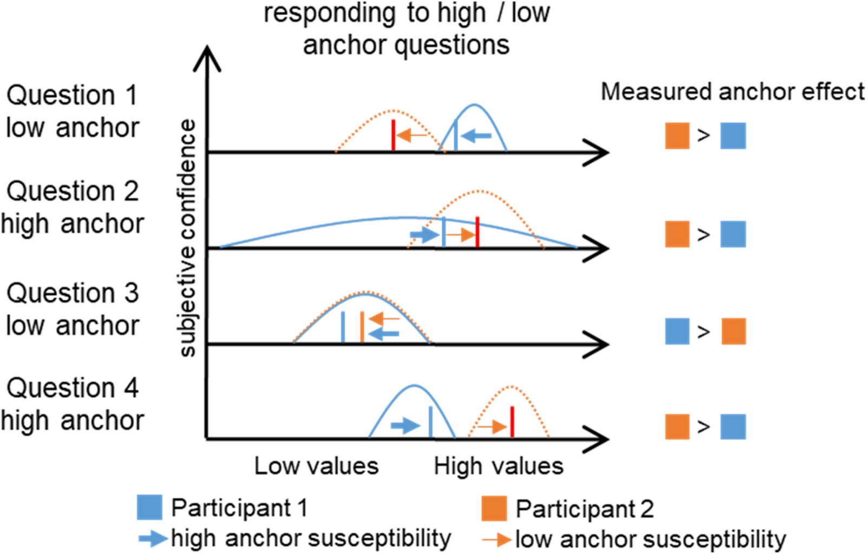
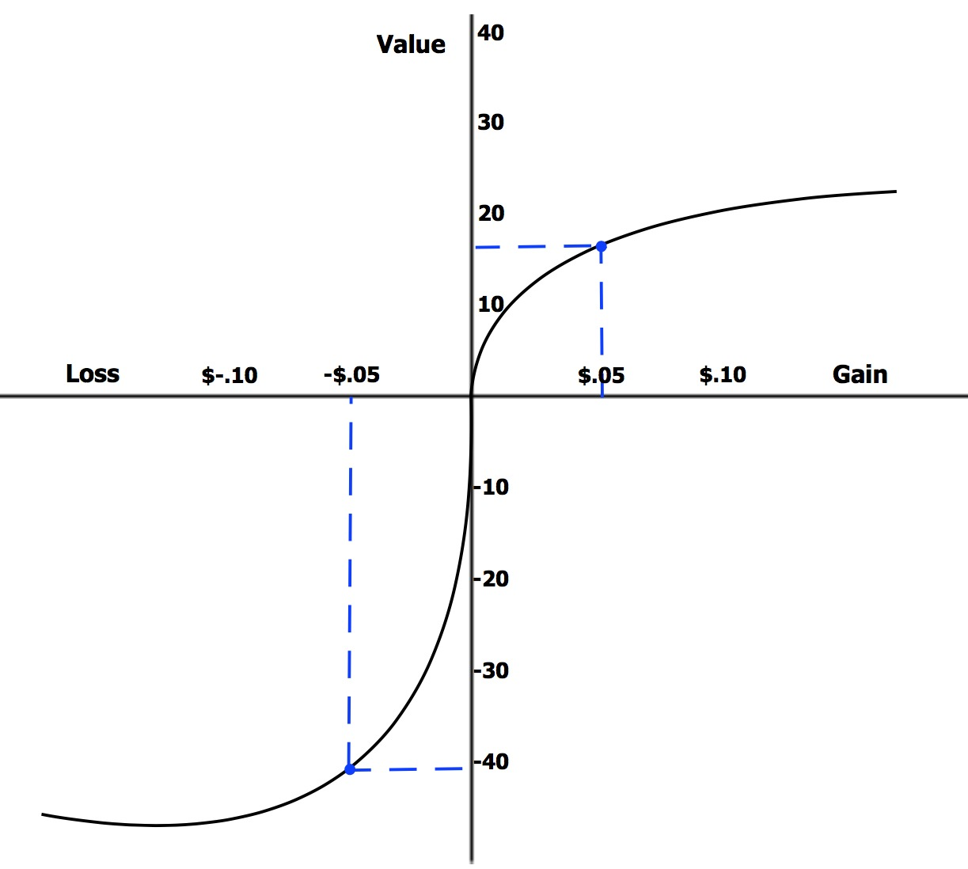
Our science is based on nobel price-winning research
3 of Minervas psychological Frameworks
Social-Emotional Selectivity
The Anchoring & Framing Effectx
Prospect Theory &
Loss Aversion

Slide 14
The Minerva workflow
Lead
incoming
Client
Information
Minerva
Research
Psychological
Frameworks
Sales
Advice

Slide 15
But we don’t stop there…

Slide 16
The Minerva workflow
Lead
incoming
Client
Information
Minerva
Research
Psychological
Frameworks
Sales
Advice
Feedback
Loop

Slide 17
Cloover will become a self improving data moat
Human in the loop
Edge Cases
Sales Conversation
Sales Data
Minerva sets
entry barriers
for their competiton
Minerva Assumption
Amount of users is
positvely correlated
to model improvement
Outcome
Improve
Compare

Slide 18
Now Marco
and all other installers
have to use Cloover

